Slide 1
Name: Dharineesh Karthikeyan
Roll.no: CB.SC.I5DAS18006
Title: AutoML App for Learning ML

Slide 2
Tentative Problem
AutoML (Automated Machine Learning) is the process of applying ML models to real-life problems using automation in the various stages such as selection, composition and parameterization of ML models.
The idea is to make an application in which the user can upload a dataset, perform all the needed tasks such as feature selection, pre-processing, model selection and hyperparameter tuning with the help of just a few button clicks, using a responsive and simple UI.
The app has a more teaching/learning focus, where beginners in ML can learn about the different stages and step by step processes needed to build a ML model, and more intermediate people can focus on experimenting with the more minute details such as hyper parameter tuning of the model.

Slide 3
Introduction
The App is built fully using python, where the UI is designed using a Python Package - “streamlit” and the backend ML codes are written using packages such as – pandas, numpy, sklearn, etc..
This app is made to work with tabular data (CSV files).
The AutoML task has been split into – Regression, Classification and Clustering. At the moment, I have completed the AutoML classification task.
Some challenges faced in automating classification task:
Since, we get the data from the user. The dataset, may contain various types of data. We should be able to identify all the categorical data and encode them accordingly, also remember them for future reference.
Every task in the ML pipelining has to be done automatically and the options must be enriched with variety for the learner to learn and experience.
The package used Streamlit, it is a stateless app. Hence, if the app reloads there is a chance for it to forget all the values such as the feature selection, hyper parameter value selected. Hence, the app has to be tested multiple times to make sure no important information is lost during entering any value.

Slide 4
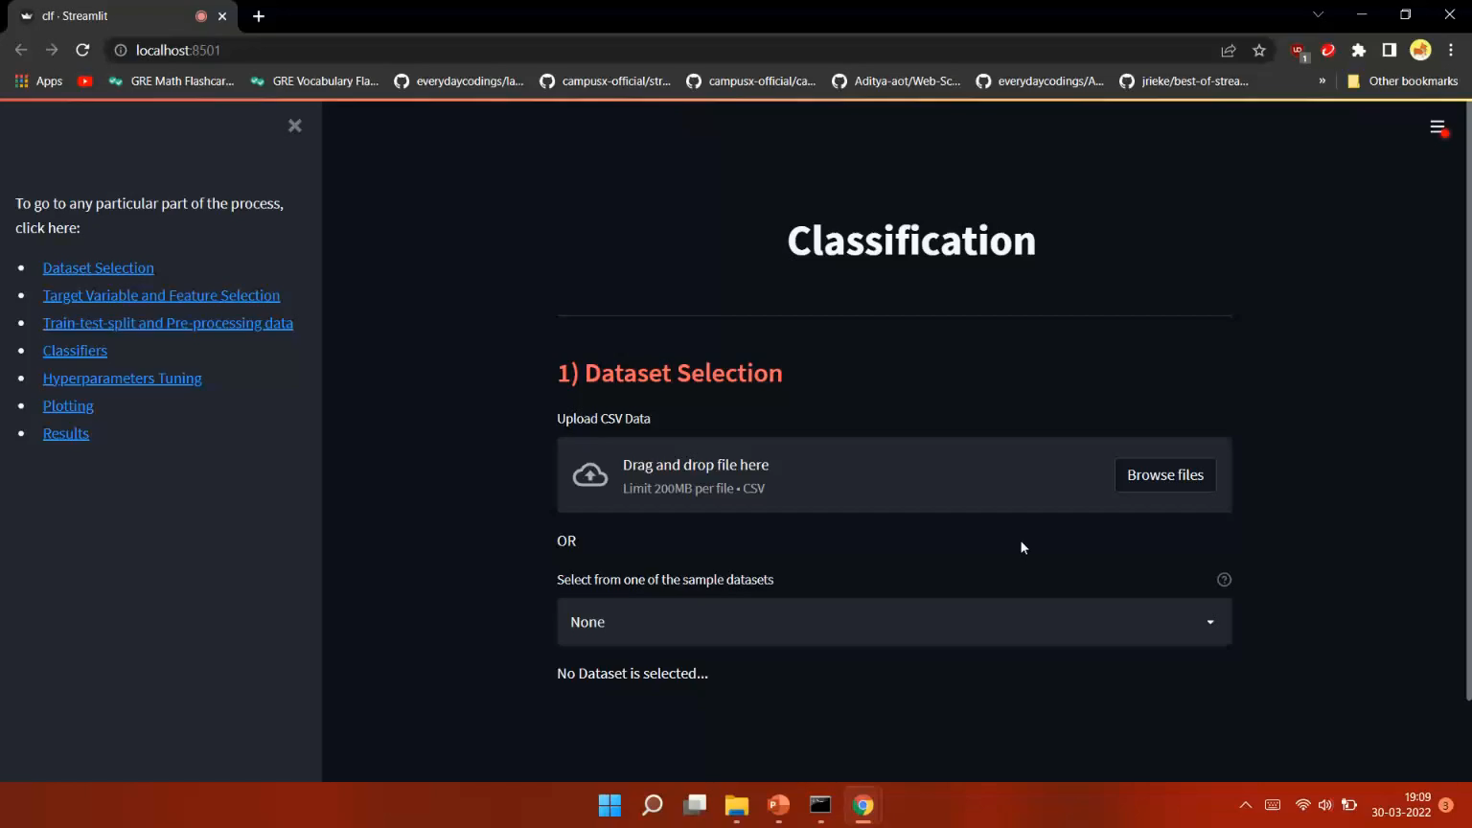
Working of the project – AutoML till Pre-processing data

Slide 5
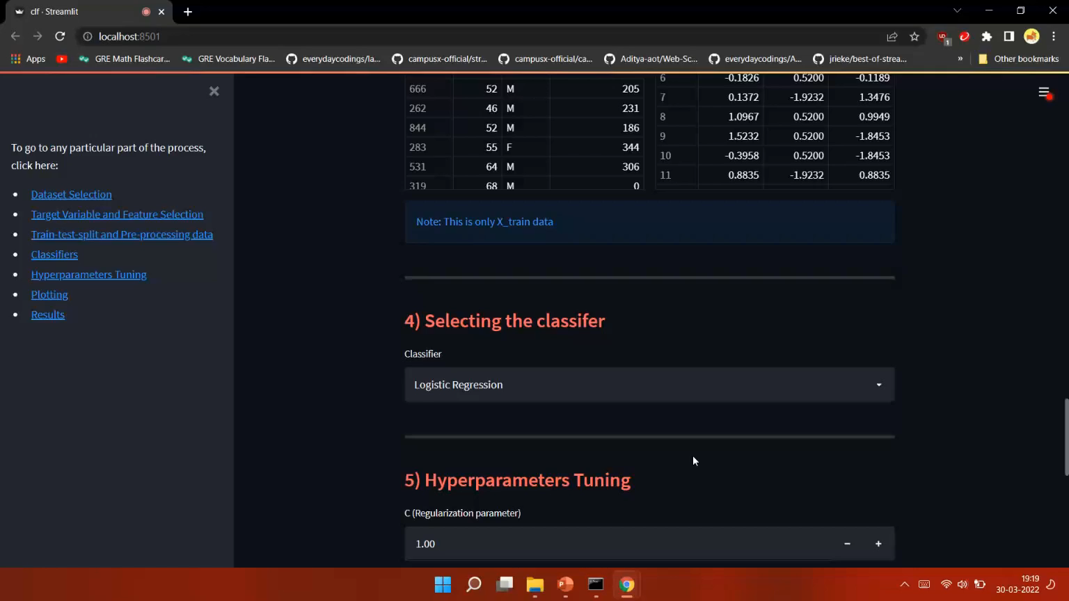
Working of the project – AutoML – Models and hyper parameter tuning

Slide 6
Future Work To be Added
AutoML for Regression and Clustering problems is the next major focus of the project. Similar to the classification problem, we must build an automated code that can detect the data and datatypes available and build a model around it.
I have worked on a single page of the App till now – Classification task. I would like to add an introduction page, to explain to new users about the app. A provide with a page selection – to go to the Classification or Regression or Clustering page as required.
At the end, I would also like to improve the AutoML classification task a little by adding more hyperparameters for the existing models and also looking into more potential ML models to be added such as Naïve Bayes, XGB Classifier, etc..

Slide 7
References
Inspiration for selecting AutoML: https://docs.microsoft.com/en-us/azure/machine-learning/concept-automated-ml
Inspiration for UI designs: https://github.com/jrieke/best-of-streamlit
Streamlit Documentation: https://docs.streamlit.io/
Sklearn Documentation: https://scikit-learn.org/stable/

